Slide 1
2244 Arçelik-ODTU Industrial Servo Drive – Autotuning
20.03.2020 Online meeting
Literature review

Slide 2
Previously on meetings
400W single ph.
750W three ph. servo
1kW for next
Off – line → On – line tuning
Pre-defined problems (mechanical)
Friction compansation
Inertia mismatch
Mechanical resonance, vibration suppression
freq. Amplitude and BW for filtering?
High – low freq. Responses?

Slide 3
Previously on meetings
CPU usage, work load sharing
CPU platform – Eval board
TMS379D
XMC4800 Infineon
Renesas
Yaskava →FPGA + DSP
Atlas Motor Samples
NOTCH Filter Examination
Least Square

Slide 4
Project Map
Literature
Problem
Building Model
Building Test Bench
Evaluating prior art solutions
Trails
Thesis

Slide 5
Mechanical Problems in literature
Vibration & Friction
Resonance (at low, high or both low-high freq.)
Amplitude (intensity)
Bandwidth (during time)
Periodic or non-periodic
Because of
motor shaft coupling, bearing, jogging, torsional etc.
reduced torque
unbalanced load
overload
low voltage, voltage drop, capacitor failure

Slide 6
How to detect Disturbance (vibration, friction) Freq.(w_cutoff) Amplitude (Q factor) and Duration (Bandwidth)?
FFT Based (Shifted Disc. Fourier Translations (SDFT), Discrete Wavelet Transform (DWT), Frequency Weighting Functions)
Iterative Learning
State variable measurement & estimation
Observers & estimation
Adaptive, Predictive
(KALMAN, MRAS, NOTCH)

Slide 7
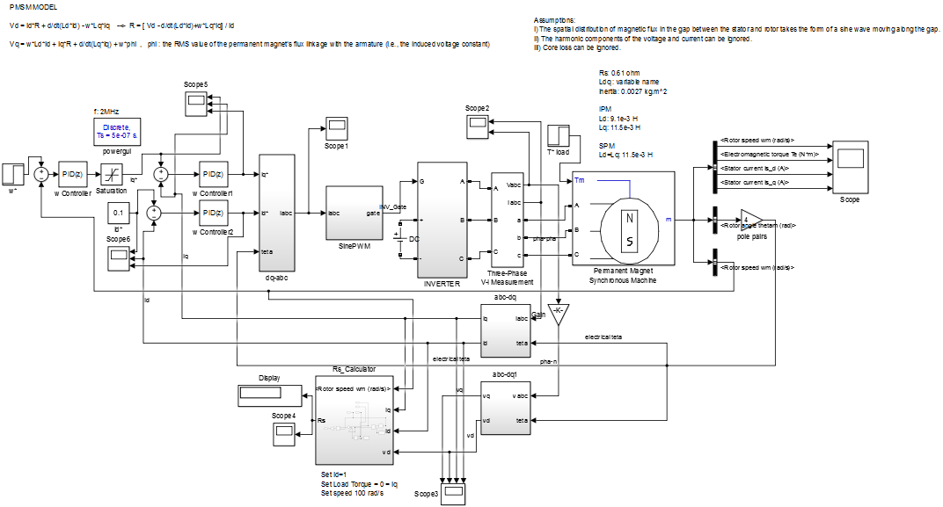
MODELLING

Slide 8
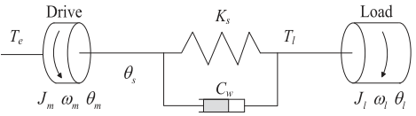
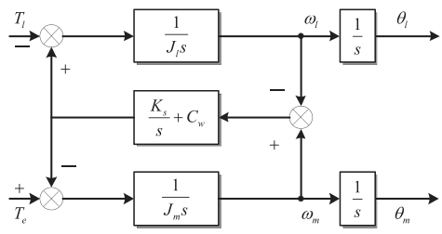
Mechanical model
Two mass system
Control of two mass system
See : Chen Y., Yang M., Long J., Hu K., Xu D., Blaabjerg F., Analysis of Oscillation Frequency Deviation in Elastic Coupling Digital Drive System and Robust Notch Filter Strategy, IEEE Transactions on Industrial Electronics, 2019

Slide 9
An excitation based OFF-LINE Autotuning (may be summer practice)
Yang S.M., Lin K.W., Automatic Control Loop Tuning for Permanent-Magnet AC Servo Motor Drives, IEEE Transactions on Industrial Electronics, 2016
A resonance freq. Detection for Autotuning (may be summer practice)
Yang S.M., Wang S., The detection of Resonance frequency in motion control systems, IEEE Transactions on Industry Applications, 2014

Slide 10
A FFT based resonance freq. Detection for Autotuning (may be summer practice)
Chen Yangyang, Yang M., Long J., Hu K., Xu D., Blaabjerg F., Analysis of Oscillation Frequency Deviation in Elastic Coupling Digital Drive System and Robust Notch Filter Strategy, IEEE Transactions on Industrial Electronics, 2019.
FFT Based solutions
Online Adaptive Notch Filter (OANF)
Robust Online Adaptive Notch Filter (ROANF)
DSP CORTEX A9 → Speed loop and ROANF
FPGA → Current Loop and FFT analysis

Slide 11
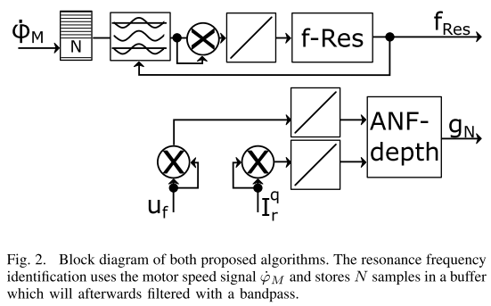
An Iteration based resonance freq. Detection for Autotuning (may be summer practice)
Aldag M., Horn J., Damping of resonance peaks using adaptive notch filters in gearless servo drives, MMAR 2017.

Slide 12
Next issues
KALMAN search (EKF)
Observer – Estimator based works
Biquad Filter implementation as NOTCH
Excitation based Autotuning implementation in my MATLAB model.

